Slide 1
Trip.com and Competitors AI Chatbot Feedback Mechanism Comparison Analysis
July 30, 2025
IBU CSC UXA

Slide 2
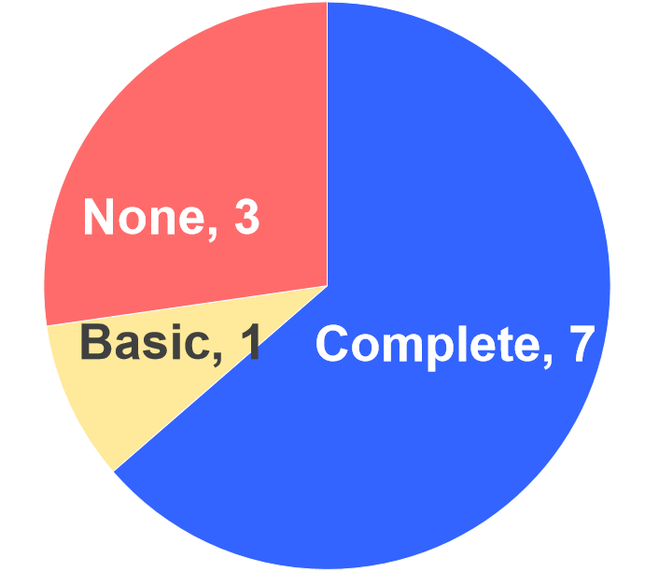
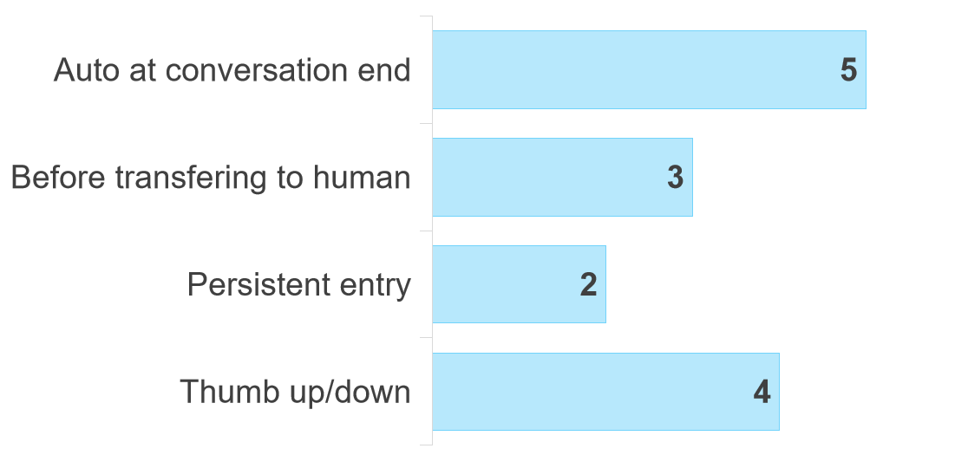
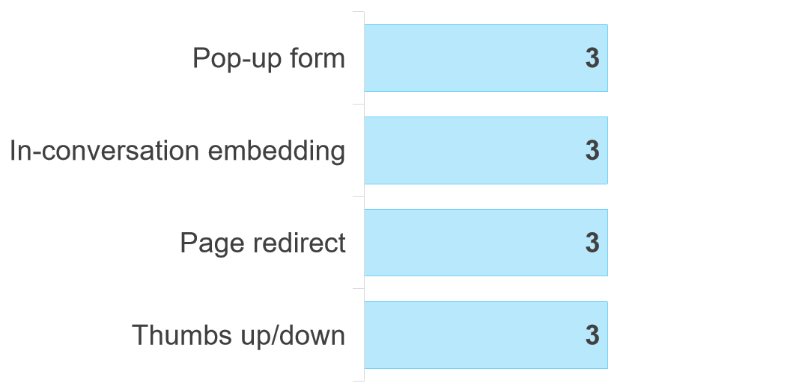
AI Chatbot Feedback Mechanism Research Overview
Research Background
AI Feedback Coverage
Current Challenge
Trip.com's AI chatbot lacks proactive feedback , with less than 1% evaluation rate.
Complete feedback - with questionnaire/scale (7):
Trip.com, Expedia, British Airways, Singapore Airlines, Cathay Pacific, United, Agoda
Basic feedback - with thumb down/up only (1):
Amazon
Research Objective
Understand how leading competitors implement chatbot feedback mechanisms to develop an effective system for Trip.com.
None - No AI chatbot evaluation (2):
Airbnb, Lufthansa, Hilton
Research Scope
Trigger Modes Distribution
Agoda, Expedia, United Airlines, British Airways, Cathay Pacific
11 platforms with AI chatbot:
4 OTAs: Trip.com, Agoda, Expedia, Airbnb
5 Airlines: British Airways, Singapore Airlines, Cathay Pacific, United Airlines, Lufthansa
1 Hotel: Hilton
1 E-commerce: Amazon
Agoda, United Airlines, Singapre Airlines
Trip.com, Expedia
Trip.com, Singapre Airlines, Expedia, Amazon
Completion Methods
Key Findings
>>
Trip.com, Expedia, British Airways
8 of 11 tested platforms have AI feedback mechanisms
Automatic trigger is most effective
In-conversation provides best UX
Trip.com: comprehensive coverage, needs UX improvements
Agoda, United Airlines, Singapre Airlines
Trip.com, Agoda, Cathay Pacific
Trip.com, Singapore Airlines, Amazon

Slide 3
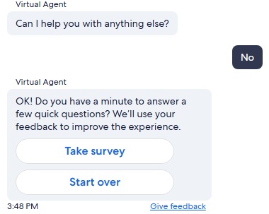

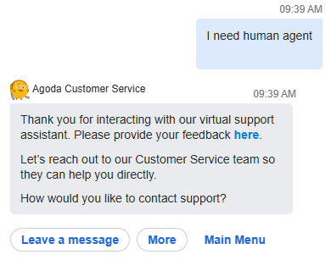


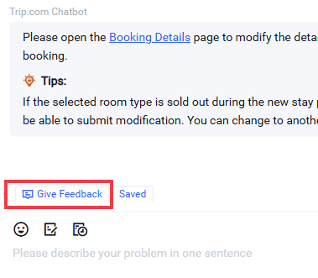
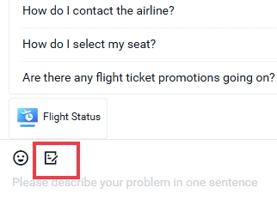
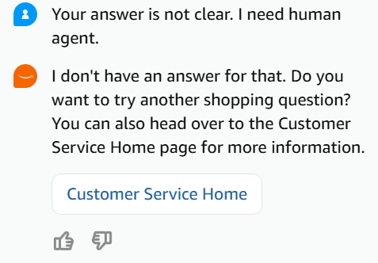

Feedback Entry and Trigger Timing
Trip.com's persistent entry flexible but lacks visibility
Automatic trigger before human transfer/at AI conversation end is most effective
Trigger Mode Classification
Trip.com Optimization Suggestion
Best timing
Targeted
1. Auto at Conversation End
Advantage: Optimal timing when user has completed their task
3. Trigger Before Human Transfer
Advantage: Precise timing for targeted AI evaluation
Current Mode
Persistent survey entry + thumbs up/down
Optimize
Add feedback proactive trigger
2. Persistent Entry for Anytime Triggering
Advantage: Maximum flexibility, but needs better visibility
Flexible
Immediate
4. Thumbs Up/Down
Succinct and immediate feedback during conversation
Implementation:
Improve visibility of "Give feedback" entry
Add proactive invitation script before human transfer/ AI Chat end (Ref: Agoda, Expedia, United Airline, Cathay Pacific)
Add automatic in-chat survey trigger at the end of AI conversation
(Ref: Singapore Airline, United Airline )

Slide 4
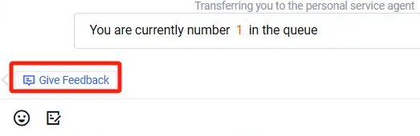
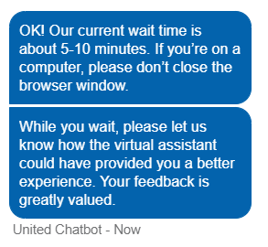
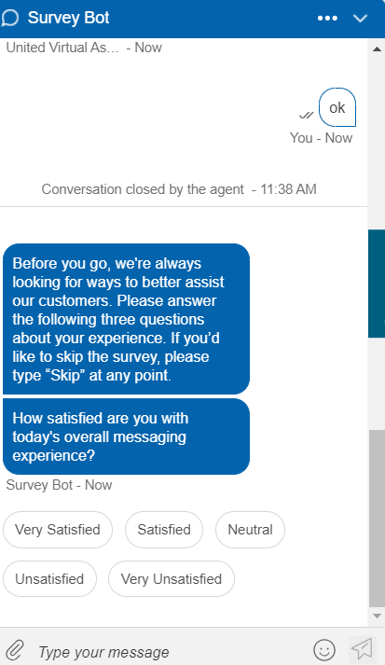
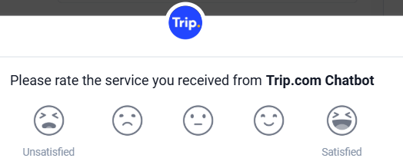
Feedback Script Quality
United Airlines provides the most comprehensive AI chat feedback invitation script.
Trip.com lacks proactive script for AI chat feedback
Best Practice: United Airlines
Trip.com Status Quo
(Script triger time: After AI conversation end, before entering Human chat)
(Script triger time: After AI conversation ends)
(Before entering human chat)
Purpose explanation
No scripts before any surveys
Expectation set up
(After AI Conversation ends)
Operation guidance
Blunt tone within survey window
Value expression
Trip.com Optimization Suggestion
Element | Scripts
Purpose | "To better assist our customers"
Value | "Your feedback is greatly valued"
Guidance | "If you'd like to skip the question, please click on 'Skip'
Expectation | "We appreciate if you could answer the following X questions"
Good Script Elements
Purpose Explanation
Operation Guidance
Why customer feedback matters
How to complete or skip
Scenarios | Scripts
Before human transfer | "Connecting to human service... Could you please provide a quick rating of our AI assistant"
Conversation end (AI) | "Thank you for choosing Trip.com! We invite you to rate this experience. Your feedback helps us improve."
Conversation end (human) | "We appreciate your feedback! Do you mind sharing more thoughts to help us improve?" (For NPS)
Expectation Management
Value Expression
Clarify question count
Indicate the importance of user's survey participation
Script Completeness: Complete (1): United Airlines; Simple (3); Agoda, Expedia, Cathay Pacific; None (3): British Airways, Singapore Airlines, Trip.com

Slide 5



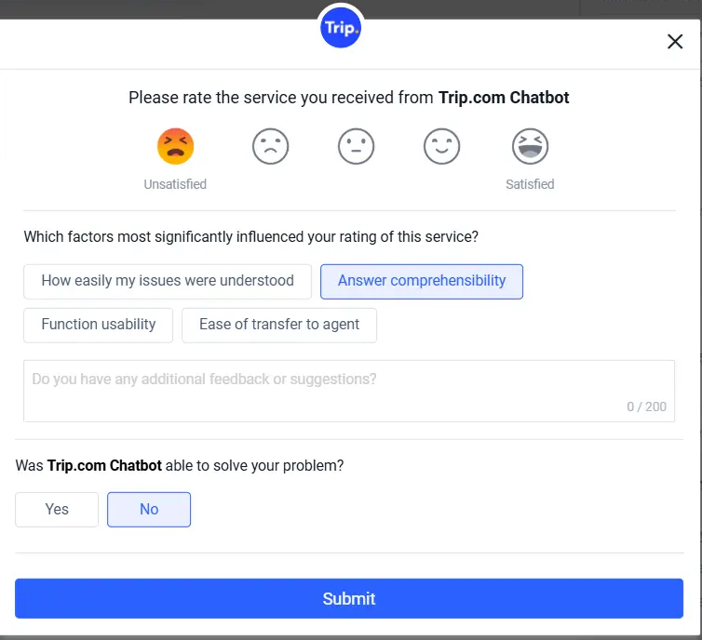
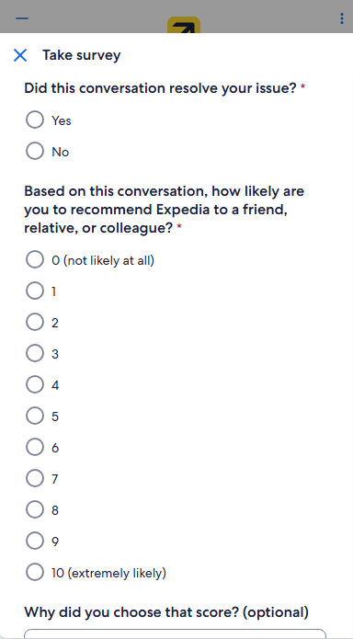
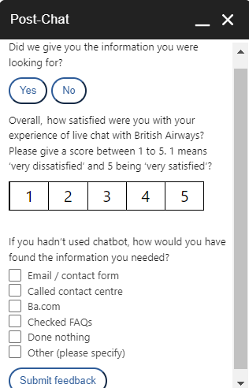
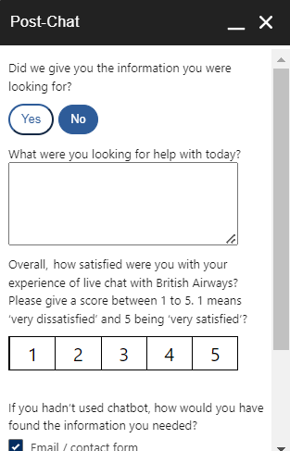

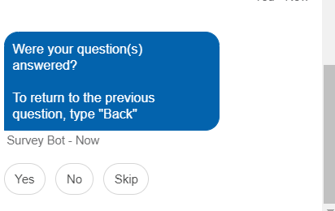
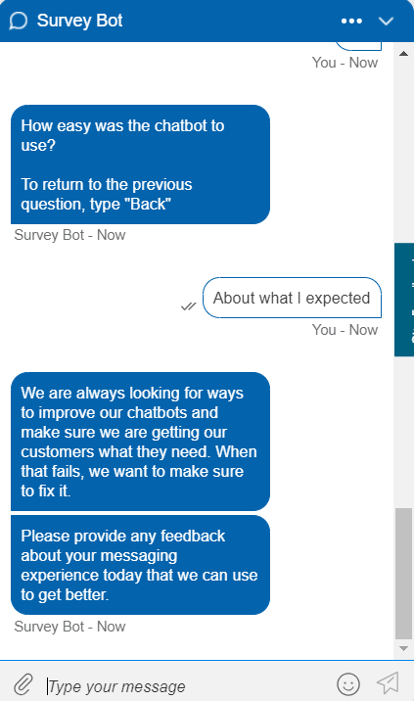
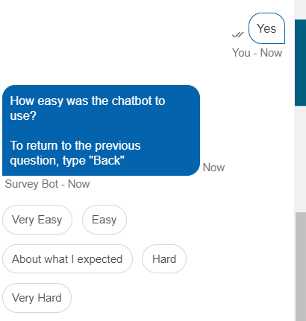
Survey Content
Current CSAT content is effective (3 core questions cover key metrics)
Evaluation Dimension Comparison
CSAT
Issue resolution
Reasons for rating
Issue resolution
NPS
Open feedback
Issue resolution
CSAT
Other channels to answer question
CSAT
Issue resolution
CES of chatbot usage
Comments
User can skip or turn back to answer, flexible and reduce interruption
Trip.com Optimization Suggestion
Reprioritize critical feedback: Move "Issue resolved?" to start. If no, auto-flag for human agent post-survey to guarantee issue resolution while preserving chatbot interaction fluency.
Reduce friction: Add a skip option to the CSAT flow to minimize user disruption.

Slide 6
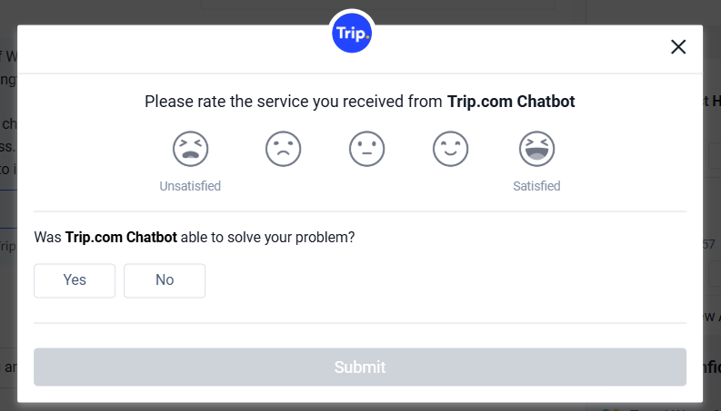
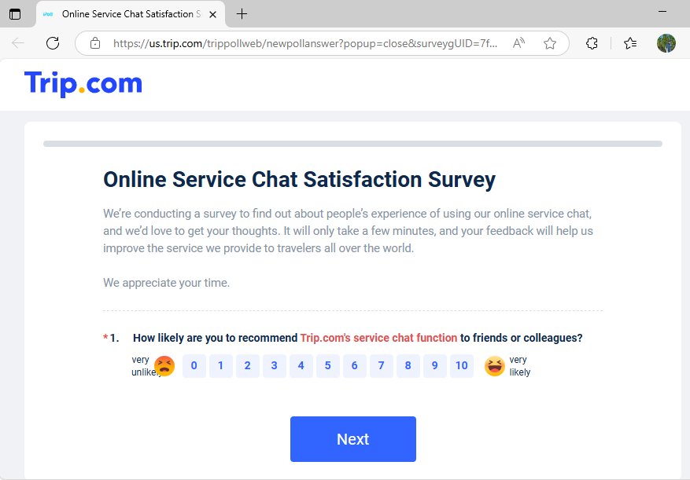
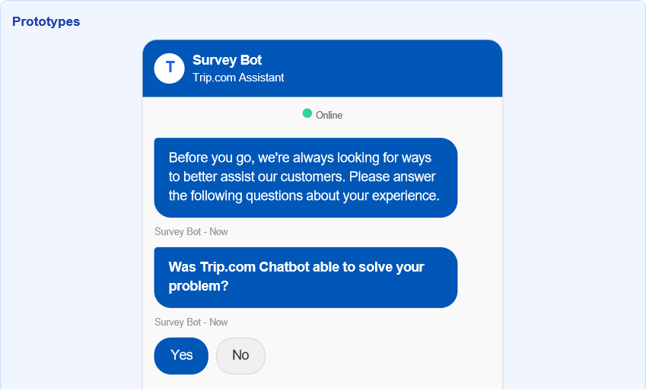
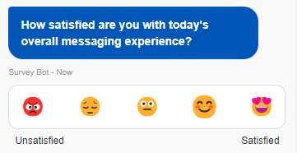

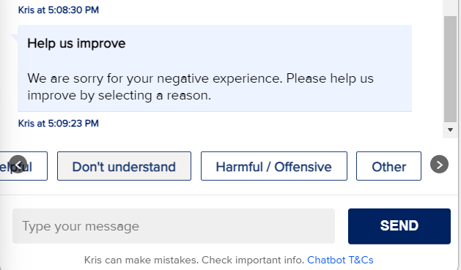

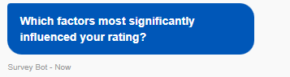
Survey Completion Methods
Pop-up/conversation/redirect forms evenly distributed
Trip.com survey forms not engaging enough, resulting in low completion rate
Completion Method Assessment
Trip.com Optimization Suggestion
1. Pop-up Form
Best for questionnaires with a few questions
2. Page Redirect
Better for long survey, fragmented user experience
Use in-conversation format for simple/short scale
End AI Chatbot
End Chat Sesstion
Transfer to Human Agent
Connecting to human service...
To better assist our customers like you, please provide a quick rating of our AI assistant
Add a skip option to the AI CSAT survey to reduce excessive interruption for users.
(Reference: United Airlines)
Skip
3. In-conversation Embedding
Simple feedback, seamless integration, more direct and engaging
Transferring to human agent usually means the problems may not be resolved, so there is no need to ask for whether Chatbot solve

Slide 7


Trip.com and Competitors Test Summary
Trip.com vs Key Competitors Comparison
Platform | Evaluation Entry | Feedback Script | Completion Method | Survey Content
Trip.com | ★★☆☆☆ | ★☆☆☆☆ | ★★☆☆☆ | ★★★★☆
Expedia | ★★★★☆ | ★★★☆☆ | ★★★☆☆ | ★★★☆☆
British Airways | ★★★★☆ | ★★☆☆☆ | ★★★★☆ | ★★★★☆
Singapore Airlines | ★★★☆☆ | ★★★☆☆ | ★★★★☆ | ★★☆☆☆
Cathay Pacific | ★★★☆☆ | ★★★☆☆ | ★★☆☆☆ | ★★★☆☆
United Airlines | ★★★★☆ | ★★★★☆ | ★★★☆☆ | ★★★★☆
Agoda | ★★☆☆☆ | ★★★☆☆ | ★★☆☆☆ | ★★★☆☆
Amazon | ★★★☆☆ | ★☆☆☆☆ | ★☆☆☆☆ | ★☆☆☆☆
Evaluation Entry: Trigger timing, visibility
Feedback Script: Completeness, courtesy
Completion Method: User experience, convenience
Survey Content: Data completeness, design
Current Problem
Disjointed chat using experience
Multiple surveys without clarification
Hard-to-find evaluation entry
Learning Benchmarks for Trip.com
Singapore Airlines
Thumbs up/down optimization → Seemless follow-up question
United Airlines
Script quality benchmark → Complete script elements
Expedia
Precise timing → Clear evaluation entry after bot phase

Slide 8
Trip.com Feedback Mechanism Analysis & Optimization
Trip.com is the only brand with triple evaluation (CSAT+NPS+thumbs up/down)
Strengths: Comprehensive dimensions, highest flexibility
Weaknesses: Weak visibility, unclear differentiation between surveys, low participation willingness
Key Optimization Strategies
1. Add Feedback Invitation
2. In-conversation Survey
3. Clear NPS Entry Point
Current:
Users need to actively click the "give feedback" button.
Proposed:
Add a script after AI session ends / before transferring to human agent and add a skip choice (Reference: United Airlines)
Benefit:
Improves evaluation participation
Current:
Pop-up form causes fragmented user experience
Proposed:
Display survey questions in-chat.
Benefit:
Lower response barrier without leaving current flow, increase CSAT visibility and boost user participation
Current:
Persistent survey icon which replies on users to discover it
Proposed:
Show NPS invitation after human session's CSAT
Benefit:
Clarify purpose, increase NPS visibility and boost user participation
Thank you for using Trip.com's AI assistant! How would you rate your experience?
😞 😐 😊 😃 😍
Did Trip.com Chatbot solve your problem?
We appreciate your feedback!
Do you mind sharing more thoughts to help us improve?
Yes
Partially
No
Take Survey
Skip
Expected Outcomes
Higher quality feedback collection
Clearer differentiation between evaluation methods
Better targeting of specific improvement areas
Enhanced user experience throughout feedback process

Slide 9
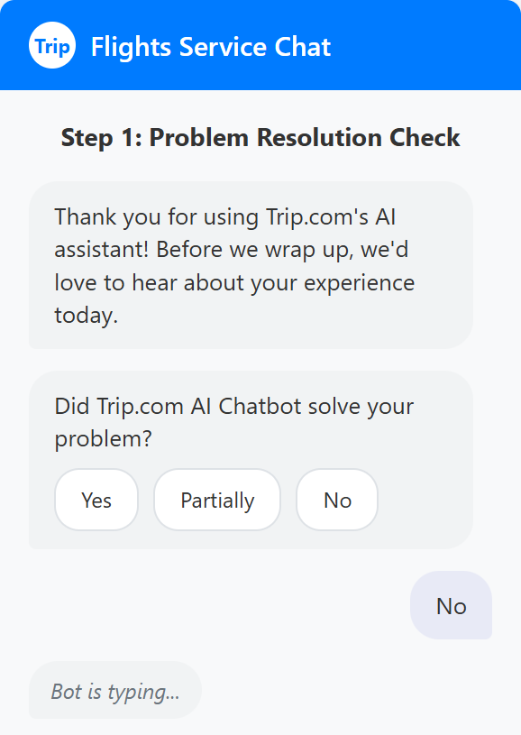
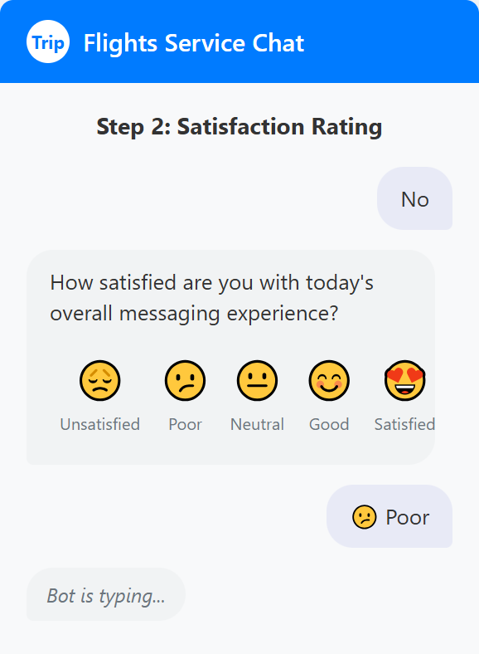
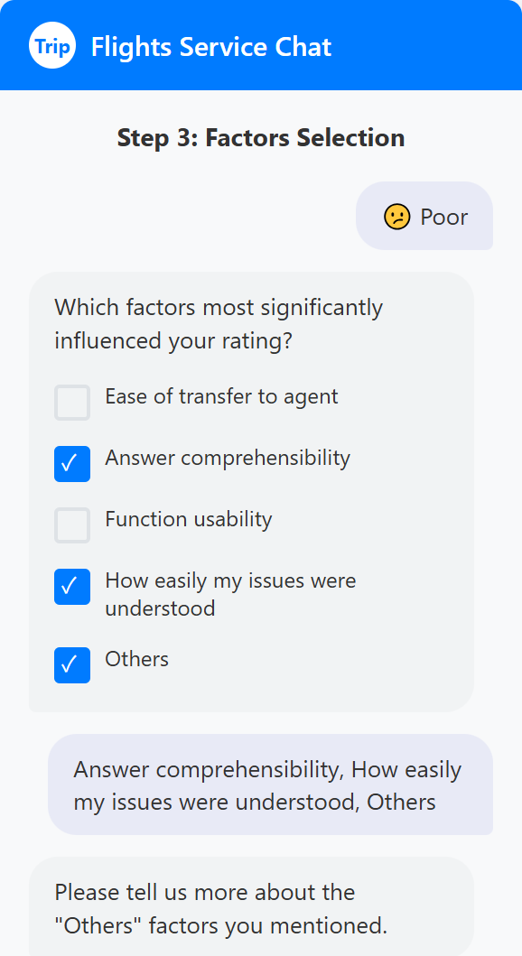
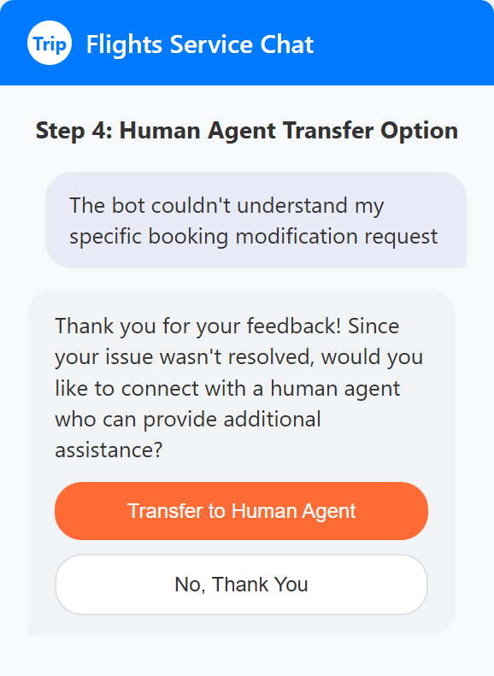
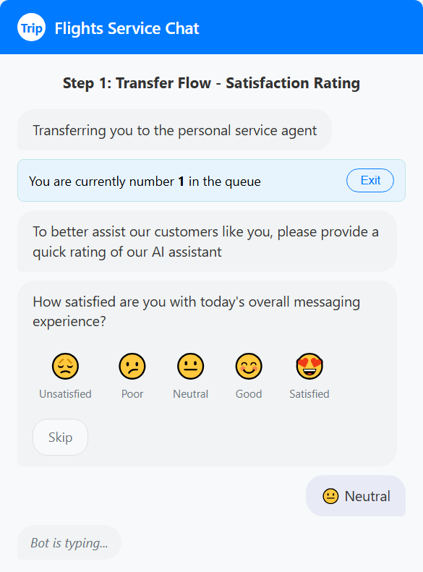
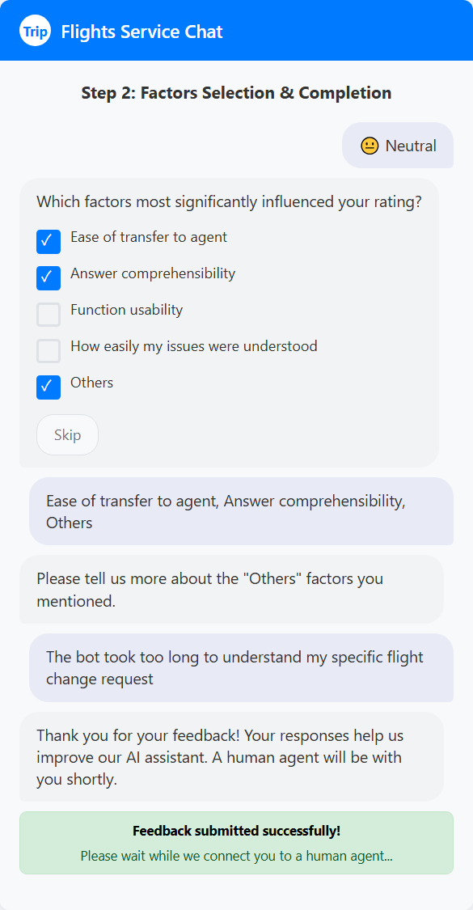
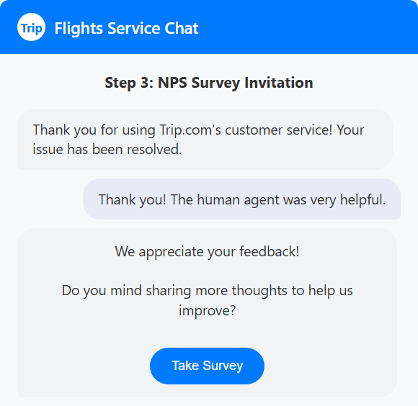
Trip.com Feedback Invitation Design
AI Feedback Invitation Procedure(Optimized)
Prototypes
AI Chat
After AI Chat Ends
Enter AI chat
Session status check
Step 1: Problem Resolution Check
Step 2: Satisfaction Rating
Step 3: Factor Selection
Step 4: Human Agent Transfer
1 No interaction (invalid session) → End
2 Complete AI chat (valid interaction) → Continue
After AI chat ends
Transfer to Human Agent
(Invitation Script 1)
(Invitation Script 2)
Pop-up Q: Was your issue resolved?
1.Yes/ Partially → continue
2 'No' → Give option to transfer to Human after survey
CSAT rating
Transfer to Human Agent
Selects reason of CSAT rating
Select 'Others'
Select other options
Step 1: Transfer Flow - Rating
Step 2: Factor Selection
Step 3: NPS Invitation
Comments (optional)
( Ending Script)
Transfer to Human (button)
Return to main interface
Enter Human chat
→ Jump to NPS survey
(After Human chat ends) NPS invitation script + NPS button
Appear after completing human sesssion rating
END

Slide 10
Appendix——AI Evaluation Systems Comparison Table
Platform | AI Evaluation | Trigger Method | Fill Method | Question Complexity | Evaluation Scale | Invitation Method | Evaluation Display Method
Trip.com | ✅ Complete system | Regular + Real-time | Pop-up window+Redirected Page | Complex (CSAT3 questions, NPS14 questions) | CSAT+NPS+Thumb up/down | None | 😊😊😊😊😊 (Emotion score) + 0-10 numbers + 👍👎 Follow-up
Agoda | ✅ Yes | Conversation result + Entry time | Jump page+In-conversation | Simple (1 question) | Survey | Yes (basic) | Very Poor🔹 Excellent (5-point experience evaluation form)
Expedia | ✅ Yes | Conversation result | Pop-up window | Simple (3 questions) | NPS+Thumb up/down | Yes (brief introduction) | 👍👎 Follow-up + 0-10 numbers (NPS)
Airbnb | ❌ No | None | None | None | None | None | AI stage development display
United Airlines | ✅ Yes | Entry time + Conversation result | Text message +In-conversation questions | Medium (3 questions) | CSAT+CES | Yes (polite greeting) | Unsatisfactory🔹Unsatisfactory (pure text 5-point scale) + Non-standard usage🔹Non-easy to use (pure text 5-point evaluation) + Open text input
British Airways | ✅ Yes | Conversation result | Pop-up window | Medium (3-6 questions) | CSAT | None | Unsatisfactory🔹Unsatisfactory (pure number 5-point scale)
Lufthansa | ❌ No | None | None | None | None | None | AI stage development display
Singapore Airlines | ✅ Yes | Real-time + Page trigger | In-conversation | Simple (follow-up selection) | Thumb up/down+Follow-up evaluation | Yes (greeting/page entry) | 👍👎 Follow-up + Left-right sliding 5-level selection (incorrect, unhelpful, don't understand, harmful/offensive, other)
Cathay Pacific | ✅ Yes | Conversation result | Jump page | Medium (5 questions) | CSAT+NPS | Yes (basic) | ⭐⭐⭐⭐⭐ (1-5 star rating) + 0-10 numbers (NPS) + Simplified/Traditional Chinese/Cancel (3-point emotion)
Hilton | ❌ No AI evaluation | Page trigger | Jump page | None | None | None | Non-AI customer accommodation experience evaluation form
Amazon | ⚠️ Basic functionality | Real-time | In-conversation | Extremely simple | Thumb up/down | None | 👍👎 Follow-up (pure follow-up evaluation)

